Slide 1
Comparison of On-Premises and Cloud Data Management
Transitioning Towards Cloud-Based Solutions

Slide 2







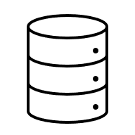


Modern Businesses Rely Heavily on Data-Driven Decisions
how does data governance achieve business success

Slide 3
Importance of Data and Data Management
In the modern digital economy, businesses now have access to an unprecedented amount of data. This wealth of information forms the bedrock of intelligence crucial for making significant business decisions.
To guarantee that employees are equipped with the appropriate data for these decisions, it's imperative for companies to invest in data management solutions that enhance visibility, reliability, security, and scalability.
With organizations generating and using data at unparalleled rates, data management solutions have become critical in navigating and understanding the immense volumes of information.
Improved Data Quality
Data Security
Better Decision Making
Lower Costs
Improved Productivity
Faster, Better Access To Information

Slide 4
Strategic Pivot: The Three Vs of Data
Businesses are increasingly defined by their ability to manage and leverage data characterized by the 3Vs: Volume, Velocity, and Variety
(a 4th V, veracity is non-negotiable as well!)
As organizations strive to harness the strategic value of data, they encounter the physical and logistical limitations of traditional on-premises data management infrastructures, especially when it comes to handling high volumes of data.
The cloud paradigm, with its inherent scalability, flexibility, and efficiency, offers a readily-implementable infrastructure that can adapt to the growing amount of data, without the need for extensive capital expenditures or the risk of underutilized resources.
The shift from traditional to a cloud-based data management is not merely a technological upgrade but a strategic necessity for organizations if they wish to remain competitive and agile in an increasingly data-driven world.

Slide 5
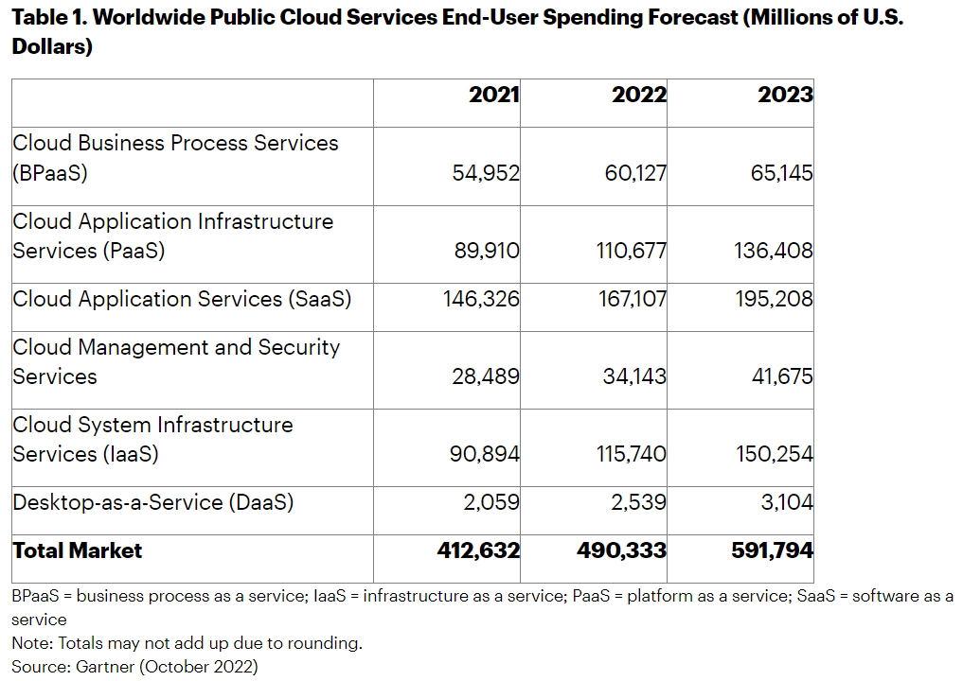
Cloudy Yet Weathering Through Unexpected Storms
“Cloud computing will continue to be a bastion of safety and innovation, supporting growth during uncertain times due to its agile, elastic and scalable nature.”
“Once applications and workloads move to the cloud they generally stay there, and subscription models ensure that spending will continue through the term of the contract and most likely well beyond. For these vendors, cloud spending is an annuity – the gift that keeps on giving.”

Slide 6
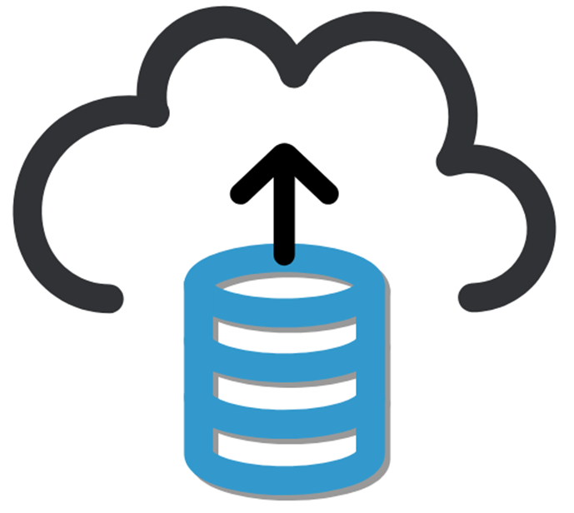
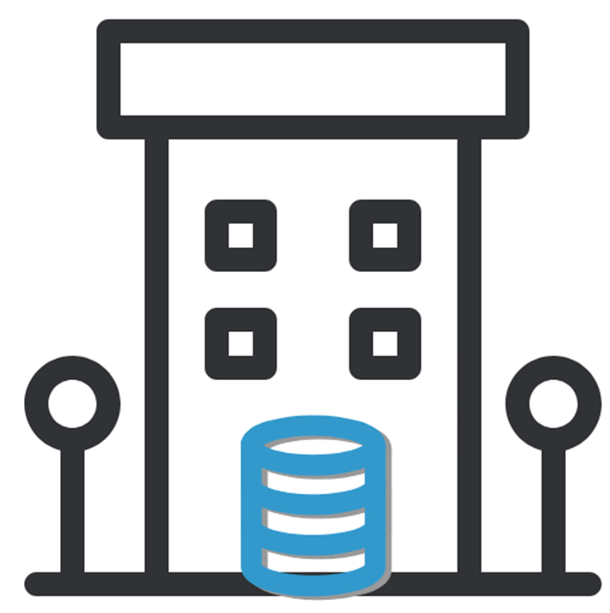
Rising to the Challenge
Literally and Figuratively
Changing Landscape of Data and its Use
On-Premises | Feature | On-Cloud
Structured, Manageable, Simple | Data Type | Unstructured, Semi-Structured
Stable and Predictable | Computing Needs | Advanced, AI/ML, real-time model deployment
Operational reports, analytics | Data Use | Globalization, remote, real-time
Sovereignty utmost important | Security | Advanced solutions allaying previously existing fears
Physical, autonomous | Control | Provided by provider, part of contract
Early-stage, controlled growth, stable business and customer base | Growth-Focus | Fast deployment, enter new markets, quickly and cheaply experiment new products/ approaches
Stable and predictable long-term needs | Costs | Pay-As-You-Go model offers $ efficiency on scale

Slide 7

This or That?

Slide 8
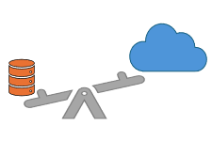
On-Premises |  |  | On-Cloud
Pros | Cons | Aspect |  | Pros | Cons
Complete control over physical infrastructure, allows custom configurations. | High upfront investment in hardware and space; ongoing maintenance. | Infrastructure and Maintenance |  | No physical data centers; infrastructure managed by cloud provider | Dependent on provider's infrastructure decisions and changes
Predictable costs after initial investment; no costs for data access. | High initial expenditure (CapEx); ongoing costs for upgrades and maintenance. | Co$t |  | Low operational expenditure with pay-as-you-go models (OpEx) | Unpredictable costs; additional fees might apply
Customizable, without any provider constraints | Limited by existing infrastructure and tecnhical resources | Flexibility |  | High; numerous choices of resources and services | Locked-In based on provider options
Tailored to business-specific needs and regulations | Org is solely responsible for security and compliance | Security Measures |  | Benefits from provider expertise and distributed responsibilities | Heavily relies on trust- and compliance-based
Direct control | Needs continuous efforts and costs to ensure proper gov & compliance | Governance and Compliance |  | Providers offer tools and services for management of DS&G | Responsibility still lies with org to ensure provider offerings meet requirements
Major advantage where speed is non-negotiable | Challenge if fast access from multiple distributed sources needed | Latency |  | Globally distributed infrastr, edge computing, CDN aim to minimize lag | Bandwidth and connection can make-or-break

Slide 9

No One-Size: Unique Needs
Both on-premise and on-cloud data management practices have their respective pros and cons. The choice depends on a variety of factors, including the willingness to invest and nature of data being handled.
Primarily, a reduction or preferable absence of third-party access and control to sensitive data is a major driver:
Educational institutions
Research and defense organizations
Insurance agencies
In other cases, a simpler and compact on-premise data management infrastructure will suffice, and on-cloud might be overkill:
Small and medium enterprises
Private, local businesses and stores

Slide 10
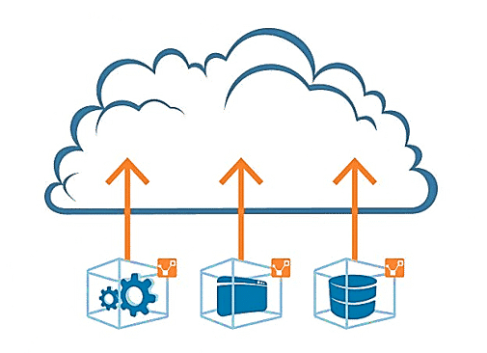
Transitioning

Slide 11
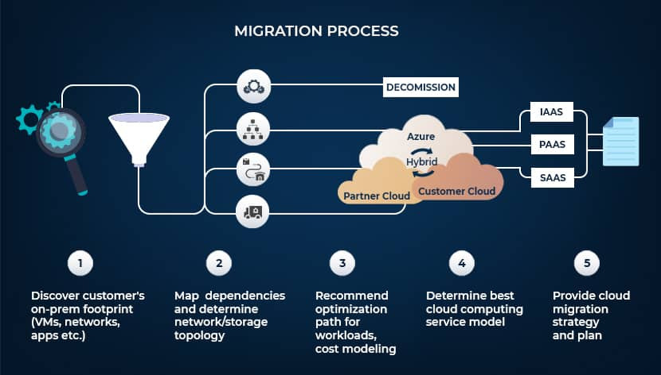
Digital Transformation: Cloud Migration
Facilitates creation of new, or modification of existing business processes, culture and customer experiences to meet changing business and market requirements.
Complex process that requires careful consideration of several challenges and considerations
Compatibility
Data migration
Security and compliance
Costs
Performance
Staffing and skills
** list neither comprehensive nor categorical – unique to each business and application

Slide 12
Data Governance in Cloud Migration
On-Premise | Aspect | On-Cloud
Managed within the organization's internal networks and servers, with direct control over where and how data is stored. Policies and procedures are developed in-house | Data Inventory and Classification | Extends beyond physical servers to include cloud storage options, requiring visibility and control over data spread across multiple cloud services Must consider cloud-specific risks, automated tools for inventory management and classification
Implemented on internal networks, with physical and network-based security measures. Control of user access and permissions can be IT-centralized | Data Access and Control | Needs cloud-based access technology Typically involves handling multiple cloud services as well as on-premise platforms in a unified manner
Focused on internal data sources, uses in-house tools and policies Limited to only what’s in direct org control | Data Quality and Integrity | Distributed systems need more sophisticated tools Continuous monitoring across all platforms
Automated or manual processes for data retention and archives Limited by physical / space constraints | Data Lifecycle Management | Automated ETL, ELT and CRUD workflows Scalable options based on volume and need
Within org network, controlled and managed based on business needs Access and compliance are internally managed | Data Flows | International data transfers not an issue, provided compliance with regulations Relies on providers global framework
** Some aspects relate to on-premise handling of data quite differently if format is physical (paper/ discs)

Slide 13
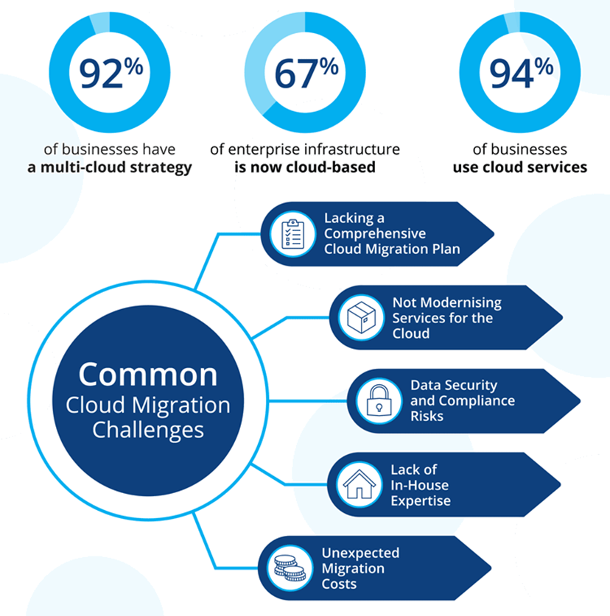
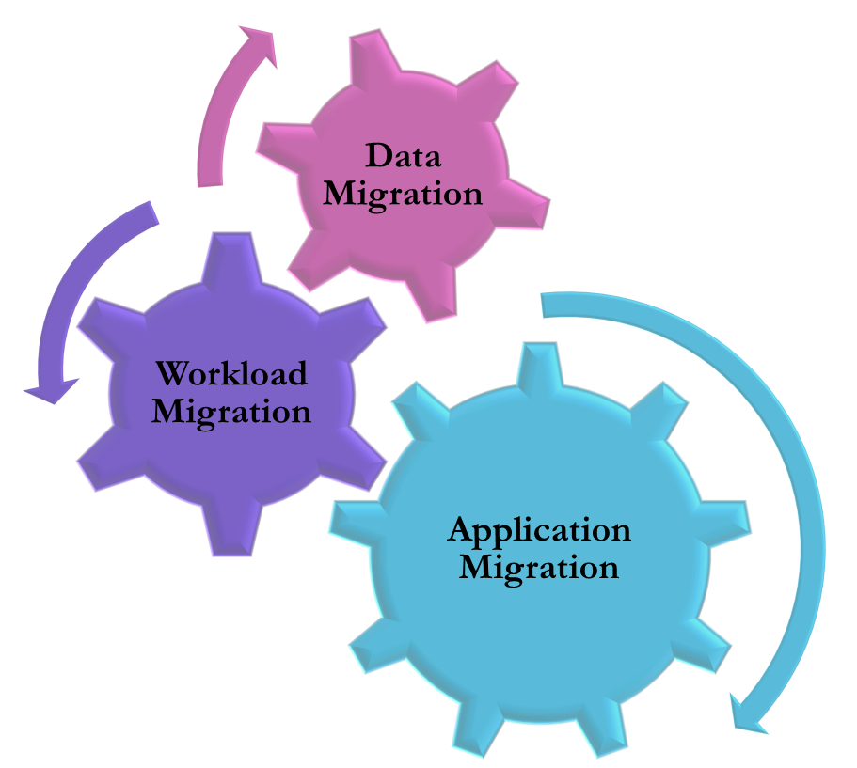
Process, Challenges and Strategies

Slide 14
Data Security and Compliance
A bad migration strategy could slow the processes down, at best. At worst, a business risks irreversible data loss or security vulnerabilities.
Data compromises during the migration process or inefficient access and control over sensitive data can be a major concern.
Most cloud services are inherently secure, but it depends largely on the integrity of the service provider.
Overcoming challenges:
Running the data through a secure route within the firewall during migration
Encrypting the data can add an extra layer of assurance
Making sure that the strategy follows industry compliance standards : CaaS tools offered by provider
Data anonymization or pseudonymization where necessary to enhance privacy: GDPR, CCPA compliance
Regular security and compliance audits and developing an incident response plan

Slide 15
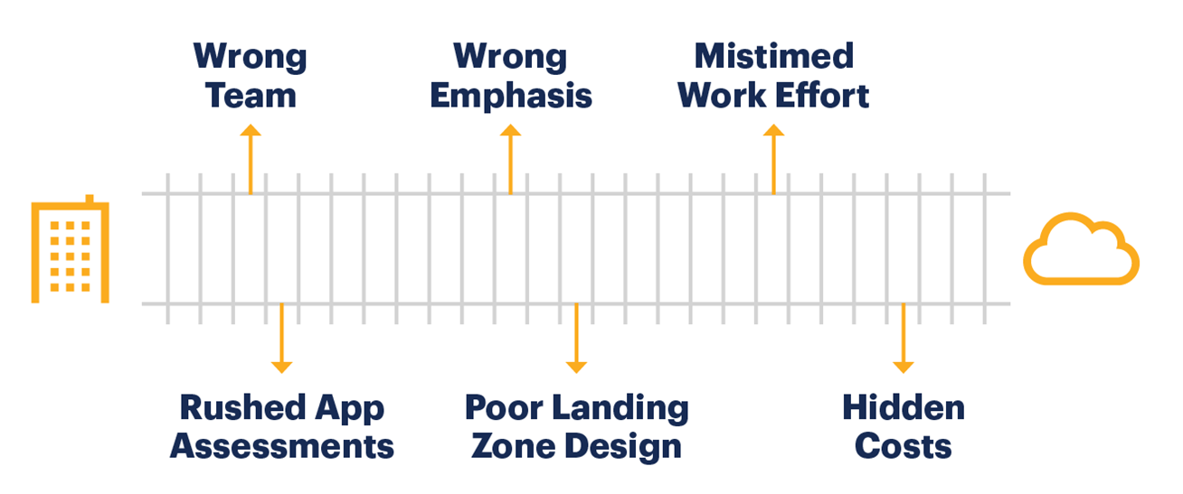
Cost Assessments
A successful cloud migration can significantly reduce operating costs in the long term.
Organizations can encounter hidden costs and expenses associated with
bandwidth
data transfer
Training and re-skilling
Vendor lock-in
Overcoming challenges:
Detailed planning and assessment + system audit
Evaluate necessary cloud resources based on current on-premise use
Use platform’s pricing calculator to estimate costs more accurately
Choosing right size and auto-scaling to avoid paying for idle resources
Batch adoption – phase-in cloud migration to spread costs over time
Training and awareness: develop a cost-conscious culture across the organization
Current staff familiar with legacy systems
Ensures continuity and smooth operation during and after transition

Slide 16
Assessment and Prioritization
Important to assess existing applications to determine their suitability for cloud migration and prioritize based on factors such as criticality, complexity, and expected benefits.
Identify current applications’ architecture, dependencies, and usage patterns
Prioritize based on expected benefits – performance and scalability
Dependencies and Integration: Applications with numerous dependencies, including external services, legacy systems, or specific hardware, present a challenge. Need to ensure that all components continue to interact seamlessly in the cloud environment.
Criticality
Applications critical to business operations should be carefully considered
ensure that cloud environment can support their requirements for security, compliance, and uptime
Complexity
Less complex applications may be ideal candidates for early migration
Can serve as a proof of concept and lowering the risk for more complex migrations later on
Benefits
Applications that stand to gain the most from cloud features should be prioritized to maximize returns
e.g., applications needing access to advanced analytics or AI services

Slide 17

Hypothetical Case Study

Slide 18
MG Corp., LLC
MG Corp., is a medium-sized e-commerce retailer headquartered in Buffalo, N.Y.
Diverse portfolio of products and has clients worldwide
Data Landscape: online platform, customer data, seller data, inventory, and analytics
Objective: Adaptation to market dynamics and customer expectations, enhance operational efficiency, reduce costs, and accelerate innovation
Scenario:
Intelligent and aggressive marketing strategies paid off; resulting exponential increase in products as well as customer base
Website slowdown and delays from high traffic
Need for faster deployment, introduction of advanced algorithms for demand forecasting, customer experience to include new data such as virtual reality (VR)
Criteria:
Customer satisfaction – while improving operational efficiency + adaptation to market dynamics
Scalability – high during peak times, and scale down during off-season
Costs – limited budget due to relatively smaller enterprise and cautious upper management
Innovation – new features, technology and predictive/analytics models

Slide 19
Assessing MG Corp’s Current Data Infrastructure
Data Assets Catalog
Clients info
Applications Review
Website backend
Usage Patterns
Product catalogs
Transaction data
Analytics reports and programs
Third-party data
Customer relationship management (CRM) software
Inventory management systems
Workloads Review
Database querys
Order processing
Customer service interactions
Analytics and reports
Peak load periods
Latency needs for real-time needs
Support for customer review videos and VR formats
* All steps involve business owner, data owners, stewards and IT personnel as appropriate

Slide 20
Identifying Migration Candidates
Business Value
Revenue impact
Cloud Compatibility
Architecture
Migration Complexity
Operational process
Dependencies
Low complexity
Need for refactoring
Data migration challenges
Integration with cloud services
Customer experience

Slide 21
Checklist: Selecting Cloud Services & Migration Strategy
Cloud Infrastructure Criteria
Scalability
Handle peak traffic
Robust support
Choice of Cloud Products
Services offered
Migration Steps
Fast and worldwide deployment
Execution
Less critical applications first
Scale options
Security measures
Latency needs
Global support
In phases
Stand alone applications earlier
Core applications: parallel phasing to ensure minimal interruptions
Cross-functional migration teams
Data stewards’ and owners’ inputs +
IT oversight
Executive and strategic alignment
Regulatory Compliance
Incidence response plan in place
Time and Span
Disaster Recovery

Slide 22
Employee Engagement and Post-Migration
Skill Gap Analysis
Surveys and reviews to identify training needs
Cloud-specific technologies upskilling
Feedback
Identify underutilized areas
Employee Awareness
Access and information on training courses, materials, in-house experts
Adaptation
Strategic adjustments
Use ongoing feedback to optimize
In-house training and workshops
Evaluate areas of improvement
Assess data accessibility and integrity
Customer feedback and service improvement
Continuously evaluate policy, governance and architectural performance

Slide 23
Summary & Conclusion
Migrating from on-premise to cloud-based data management is a critical decision that can result in improved efficiency, cost savings, and significant competitive advantage.
From a data governance perspective, there will be a significant shift in how data is stored, accessed, and secured: inventory, compliance, lifecycle management and data flow.
The process requires careful planning, execution, and ongoing management to fully realize its benefits.
Each step depends on a clear understanding of the organization's goals.
Success relies heavily on detailed preparation and an active involvement of relevant stakeholders throughout the process.

Slide 24
References
“What is On-Premises Data Centers vs. Cloud Computing,?”, Hewlett Packard Enterprise, accessed 2 March 2024 <https://www.hpe.com/us/en/what-is/on-premises-vs-cloud.html>
“Blog: On Premise vs. Cloud: Key Differences, Benefits and Risks”, Cleo, accessed 12 March 2024 <https://www.cleo.com/blog/knowledge-base-on-premise-vs-cloud>
“Data Security in Biotech: Navigating the Cloud-Based vs On-Premise Debate”, SciNote, accessed 29 February 2024, <https://www.scinote.net/blog/cloud-based-vs-on-premise/>
Paul Diamond, “Cloud storage vs. on-premises servers: 9 things to keep in mind”, accessed 2 March 2024, <https://www.microsoft.com/en-us/microsoft-365/business-insights-ideas/resources/cloud-storage-vs-on-premises-servers >
“Why Are Universities Choosing On-Premise Data Centres?”, Secure IT Environments Ltd., accessed 2 March 2024, <https://siteltd.co.uk/blog/universities-data-centres/#:~:text=When%20a%20university%20buys%20a,maintenance%2C%20upgrades%2C%20and%20costs. >
“How to Avoid These 5 Common Cloud Migration Challenges” Dunedin IT, accessed 17 March 2024, <https://www.dunedinit.co.uk/blog/how-to-avoid-these-5-common-cloud-migration-challenges/>
Bandari, V. (2022)Optimizing IT Modernization through Cloud Migration: Strategies for a Secure, Efficient and Cost-Effective Transition, Applied Research in Artificial Intelligence and Cloud Computing, 5(1), pp. 55–65
“Why Cloud Migrations Projects Fail”, Process Tempo Inc., accessed 11 March 2024, <https://www.linkedin.com/pulse/why-cloud-migrations-projects-fail-processtempo/ >
Felici, M., Pearson, S. (2015). Accountability for Data Governance in the Cloud. In: Felici, M., Fernández-Gago, C. (eds) Accountability and Security in the Cloud. A4Cloud 2014. Lecture Notes in Computer Science(), vol 8937. Springer, Cham.
Al-Ruithe, M., Benkhelifa, E. & Hameed, K. A systematic literature review of data governance and cloud data governance. Pers Ubiquit Comput 23, 839–859 (2019).
N. Ahmad, Q. N. Naveed and N. Hoda, "Strategy and procedures for Migration to the Cloud Computing," 2018 IEEE 5th International Conference on Engineering Technologies and Applied Sciences (ICETAS), Bangkok, Thailand, 2018, pp. 1-5.
“What is Cloud Migration? A Guide to Migrating to the Cloud”, IR Team, accessed 11 March 2024, <https://www.ir.com/guides/migrating-to-the-cloud>
“Migration Challenges: Understanding the Complexities and Strategies in Migrating On-Premise Customers to Cloud SaaS Platforms” accessed 15 March 2024, <https://www.linkedin.com/pulse/migration-challenges-understanding-complexities-migrating-cooper/>
“How to Migrate to Cloud: A Winning Cloud Migration Strategy”, Amit Govil, CueLogic, accessed 18 March 2024, <https://www.cuelogic.com/blog/cloud-migration-strategy>
“Industry Trends In Cloud Migration And Adoption Strategies”, Successive Cloud, accessed 28 February 2024, <https://successive.cloud/industry-trends-in-cloud-migration-and-adoption-strategies/>

